Slide 1
Social Buzz Data Analytics

Slide 2
Today’s Agenda
Project recap
Problem
The Analytics team
Process
Insights
Summary

Slide 3
Project Recap
Social Buzz is a technology-oriented platform that seeks to adapt quickly to its global scale.
This project seeks to:
Conduct an audit of Social Buzz’s big data practice
Give recommendations for a successful IPO
Perform an analysis to find Social Buzz’s top 5 most popular categoreis

Slide 4
Problem
Over 10000posts per day
36,500,000 pieces of content per year
How to capitalize on the data so much?
Analysis to find Social Buzz top 5 most popular categories of content.

Slide 5
The Analytics Team
Andrew Fleming – Chief Technical Architect
Marcus Rompton – Senior Principle
Collins Onyango – Data Analyst

Slide 6
Process
Data Understanding
Data Cleaning
Data Modelling
Data Analysis
UncoverInsights

Slide 7
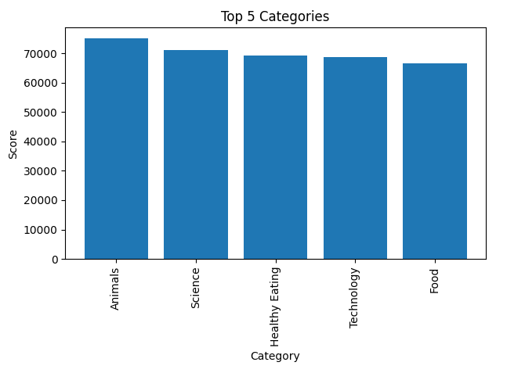
INSIGHTS: Top 5 Categories

Slide 8
How many unique categories are there?
There are 16 categories
Studying
Healthy Eating
Technology
Food
Cooking
Dogs
Soccer
Public Speaking
Science
Tennis
Travel
Fitness
Education
Veganism
Animals
Culture

Slide 9
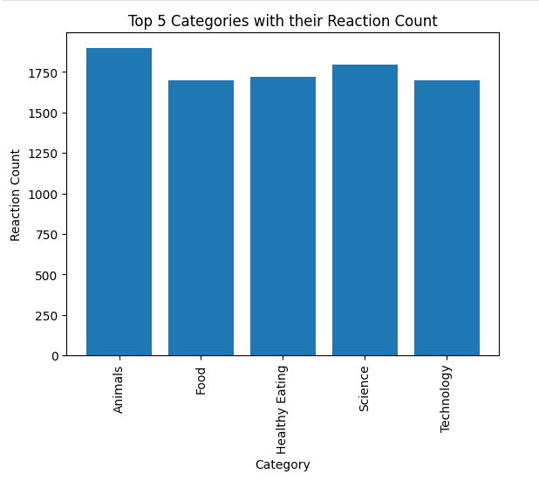
INSIGHTS: Top 5 Content Categories with their Reaction Count

Slide 10
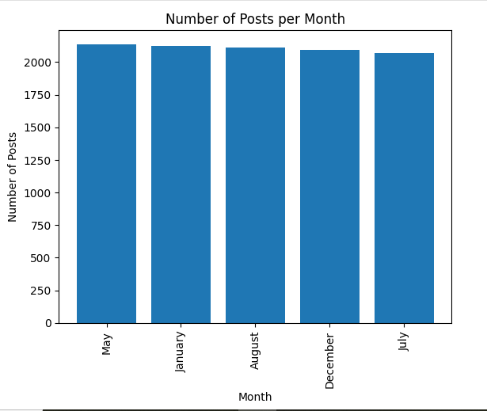
What was the month with the most posts?
The month with the most posts is the month of May.

